Slide 1
SASSI Tutorial
Mark Stephenson, Senior Research Scientist
Daniel R. Johnson, Senior Research Scientist
NVIDIA Research

Slide 2
9:00 am | WELCOME
9:30 am | Session 1
10:50 am | BREAK
11:30 am | SESSION 2
12:50 pm | BREAK
1:30 pm | Session 3
2:50 pm | BREAK
3:30 pm | SESSION 4
 | Q&A
AGENDA

Slide 3
1 | (Brief) Introduction to GPUs
2 | (Brief) Introduction to CUDA
3 | (Brief) Introduction to software stack
4 | Introduction to SASSI
5 | SASSI Setup
6 | First Example
7 | Break
Session 1

Slide 4
acknowledgements
Danny Johnson
Siva Hari
Vyas Venkataraman
Doug Saylor
Matt Sinclair
Dave Nellans
Si Li
Neal Crago
Yunsup Lee
Mike Sullivan
Caroline Trippel
Isaac Gelado
Jason Cohen
Steve Keckler
Oreste Villa
Niladrish Chatterjee

Slide 5

Motivation
Many GPU architecture studies don’t require simulation
CUPTI & SASSI might be a good fit for your needs

Slide 6
GPU Basics

Slide 7
BRIEF INTRODUCTION TO GPUs
High Level Overview
Not a complete, definitive treatment ☺
Massively parallel, multi-threaded accelerator processors
Data-parallel computation
Organized as a collection of “Streaming Multiprocessors” (SMs)
10s of thousands of threads, hide memory latency
100s of GB/sec of memory bandwidth

Slide 8
Streaming Multiprocessors
SM is the hardware unit of replication for processing
SMs execute threads in groups called warps
Warps for NVIDIA hardware are 32 threads wide
Up to 64 schedulable warps/SM on Kepler GK110
Warps execute in a Single Instruction Multiple Thread (SIMT) fashion
Similar to SIMD, but hardware automatically handles control flow divergence
Divergence: when all threads in a single warp don’t take the same control path

Slide 9
Gpu Block Diagram
Courtesy of Niladrish Chatterjee
WARPS
THREADS
SM
Lockstep execution
Warp stalled on memory access
SM
I
N
T
E
R
C
O
N
N
E
C
T
SM
Warp 1
Memory Partition
Warp Scheduler
Warp 2
Memory Controller
Warp 3
L2 Slice
GDDR5
GDDR5
Warp N
Channel
SIMD Lanes
Memory Partition
RFile
L2 Slice
Memory Controller
GDDR5
GDDR5
L1
Shared
Memory Port
Channel

Slide 10
SM Architecture
Local Memories
SMs have large register files to support large thread count
e.g., 64K 32-bit registers on GK110 (256 kB)
Up to 255 registers per thread
SMs have local scratchpad memory known as Shared Memory
e.g, up to 48 kB/SM on GK110
SMs have relatively small L1 caches (16kB / 32kB / 48kB per SM)
SRAM configurable as cache or shared memory (64 kB total)

Slide 11
Memory system
Courtesy of Niladrish Chatterjee
SIMD Lanes (32)
No global cache coherence
Coalescer has limited efficacy in irregular workloads
Partial hits in L1 and L2
1st source of latency divergence
DRAM requests can have varied latencies
Warp stalled for last request
DRAM Latency Divergence
Load Inst
Access Coalescing Unit
L1
L2
GDDR5

Slide 12
Other Notable Features
Atomic operations:
Fast global memory atomics at L2 (Fermi, Kepler), shared memory atomics (Maxwell)
Warp-level Collectives operations: communicate across threads
vote (predicate reduction: all/any/uniform) or ballot (collect predicate mask)
shuffle (data exchange)
Some hardware performance counters are exposed as special registers
Programmers can use inline PTX to access them

Slide 13
CUDA Basics

Slide 14
Very BRIEF INTRODUCTION TO cuda
Again, not a complete, definitive treatment ☺
CUDA: a parallel computing platform and programming model enabling use of GPUs for general purpose computing
Languages include C, C++, Fortran, and others
CUDA for this presentation: CUDA C++
Most code for this tutorial is just C/C++ with a few notable differences
Basic concepts and terminology
Notes:
See
http://devblogs.nvidia.com/parallelforall/easy-introduction-cuda-c-and-c/
And
Kepler GK110 Architecture Whitepaper

Slide 15
CUDA Programs
Developers write kernels
Parallel functions that execute across the GPU in many parallel threads
Each thread executes an instance of the kernel, SPMD style
Kernels can be decomposed into functions
Threads are organized into a grid of thread blocks
Threads get 3D (x,y,z) Block ID (within grid) and Thread ID (within block)
Notes:
NOTE: this could be split into two slides, the Thread Blocks stuff could be a separate slide to avoid crowing….
See
http://devblogs.nvidia.com/parallelforall/easy-introduction-cuda-c-and-c/
And
Kepler GK110 Architecture Whitepaper

Slide 16
Grids and blocks
Host
Device
Adapted from Mary Hall’s CS4961 deck, University of Utah
Grid 1
Kernel 1
Block
(0, 0)
Block
(1, 0)
Block
(2, 0)
Kernels execute as a grid of thread blocks
Threads share global memory space
A thread block is a batch of threads that can cooperate with each other by:
Synchronizing their executing
Sharing data through a low-latency shared memory
Two threads from two different blocks can’t cooperate
Block
(0, 1)
Block
(1, 1)
Block
(2, 1)
Grid 2
Kernel 2
Block (1, 1)
Thread
(0, 0)
Thread
(1, 0)
Thread
(2, 0)
Thread
(3, 0)
Thread
(4, 0)
Thread
(0, 1)
Thread
(1, 1)
Thread
(2, 1)
Thread
(3, 1)
Thread
(4, 1)
Thread
(0, 2)
Thread
(1, 2)
Thread
(2, 2)
Thread
(3, 2)
Thread
(4, 2)
Fine print: Experts can do this, but it’s not condoned in the programming model and beyond our scope

Slide 17
Block and thread ids
Adapted from Mary Hall’s CS4961 deck, University of Utah
Device
Threads and blocks have IDs
Each thread can use IDs to decide what data it needs to work on
Block ID: 1D or 2D (blockIdx.x, blockIdx.y)
Thread ID: 1D, 2D, or 3D (threadIdx.{x,y,z})
Lane ID: Lane within a warp of the thread, 0:31
Frequently used in SASSI handlers
Simplifies memory addresses when processing multidimensional data
Grid 1
Block
(0, 0)
Block
(1, 0)
Block
(2, 0)
Block
(0, 1)
Block
(1, 1)
Block
(2, 1)
Block (1, 1)
Thread
(0, 0)
Thread
(1, 0)
Thread
(2, 0)
Thread
(3, 0)
Thread
(4, 0)
Thread
(0, 1)
Thread
(1, 1)
Thread
(2, 1)
Thread
(3, 1)
Thread
(4, 1)
Thread
(0, 2)
Thread
(1, 2)
Thread
(2, 2)
Thread
(3, 2)
Thread
(4, 2)
© David Kirk/NVIDIA and Wen-mei W. Hwu, 2007
ECE 498AL, University of Illinois, Urbana-Champaign

Slide 18
CUDA Keywords
Simple CUDA Program Template
__device__ void device_function() { // a function that runs on the GPU
...function implementation here...
}
__global__ void kernel(void) { // a kernel that runs on the GPU
device_function();
}
int main( void) {
kernel<<<1,1>>>(); // a kernel launch from host code
printf( "Hello, World!\n" );
}
Notes:
Stolen some inspiration from http://www.nvidia.com/content/gtc-2010/pdfs/2131_gtc2010.pdf
TODO: add callouts with explanation like other code slides?
TODO: change heading/subheading?

Slide 19
Memory spaces
Memory spaces (isspacep)
Global: any thread in any thread block can access (__isGlobal(const void*))
Features several useful atomic operations
Data can be cached
Local: local to a given thread (__isLocal(const void*))
Used for stack allocation & spills & fills
Data can be cached
Shared: shared among threads of a thread block (__isShared(const void*))
Features several useful atomic operations
Constant
Generic: can be global, local, shared, or const

Slide 20
CUDA for SASSI USERS
What you need to know for this tutorial
SASSI handlers are device functions written in CUDA C/C++
In general, they analyze data at the thread and warp granularities
SASSI handlers make use of device intrinsics, such as…
Warp wide primitives (e.g., votes, shuffles described earlier)
Atomic operations
Target applications more complex than SASSI handlers in general
Notes:
NOTE: do we want this or is it too redundant with later?

Slide 21
Software Stack

Slide 22
Introduction to software stack
Compiling, Linking, CUPTI
Compiler flow
The compiler generates code for the host and the device
Front-end and back-end compiler
nvvm, ptxas
Linker links together the device modules
CUDA runtime
Installs device code, schedules CTAs, performs memcopies, etc.
CUPTI lets us intercept and act upon various events
Notes:
Slightly more complicated than a traditional compilation flow because we have to generate code for the host and device. For really simple applications, nvcc can take care of all of the complexities of this for you. But for applications that do cross-module function calls or use libraries, you have to understand the compiler flow. SASSI injects CUDA ABI-compliant function calls into the application, so we have to understand the compilation flow.

Slide 23
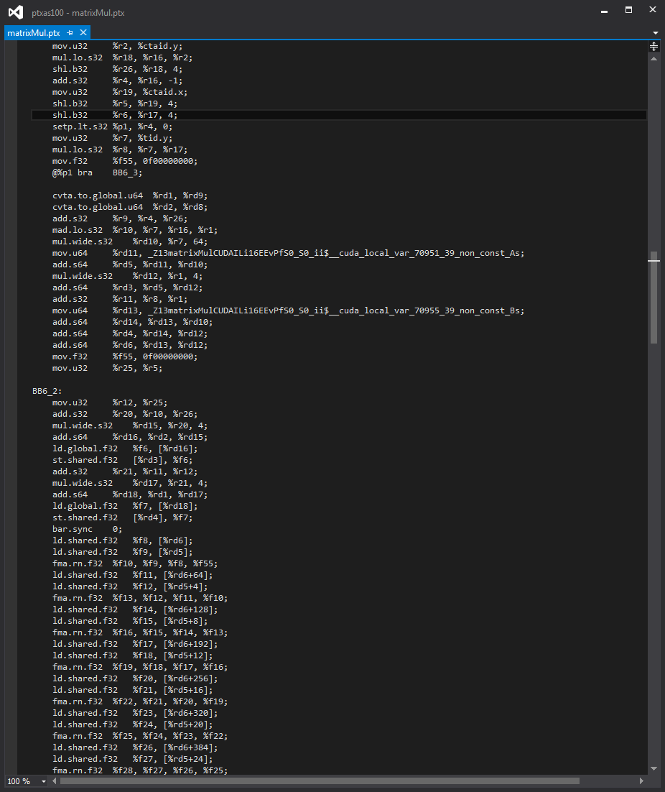
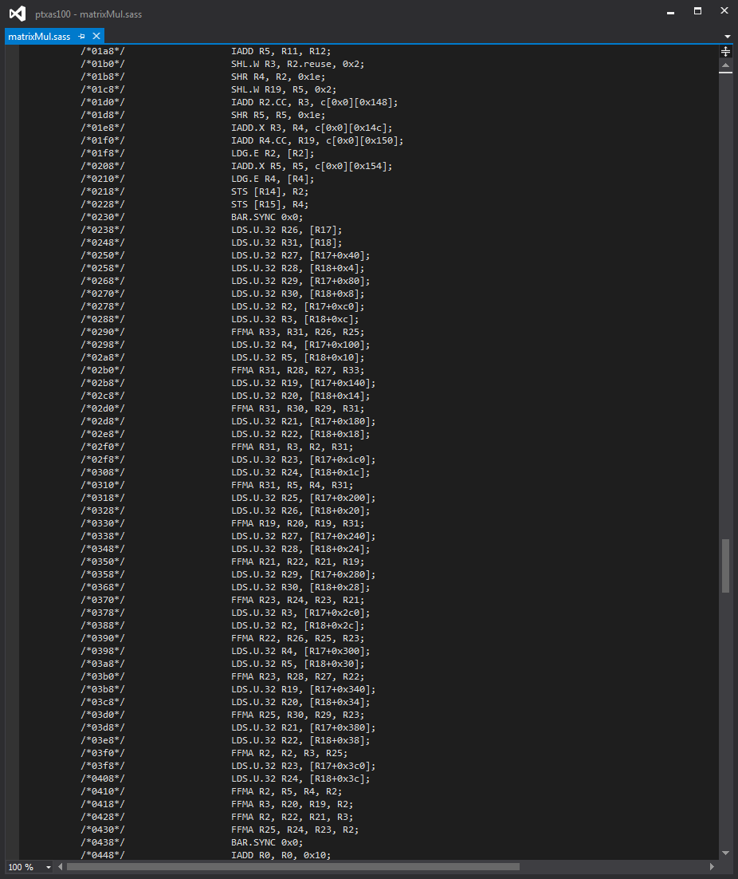
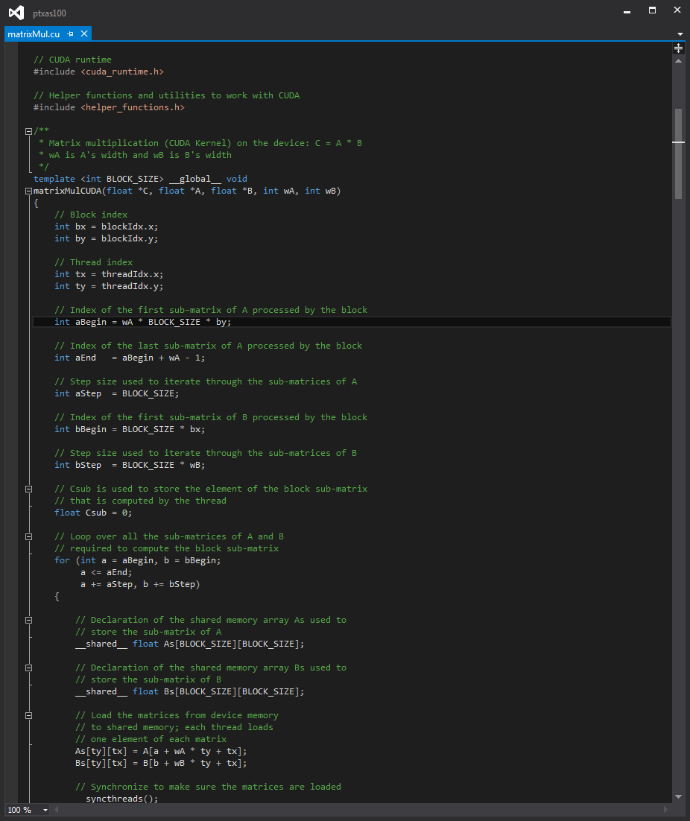
Compiler flow
No Cross-Module Calls
Ahead-of-time compilation
nvvm
ptxas
nvlink
PTX
SASS
sourceB.cu
Just-in-time compilation
GPU
nvcc
nvcc
nvvm
ptxas
sourceA.cu
PTX
SASS

Slide 24
Compiler flow
With Cross-Module Calls
Ahead-of-time compilation
nvvm
ptxas
nvlink
PTX
SASS
sourceB.cu
Just-in-time compilation
GPU
nvcc
nvcc
We have to compile our sources with the “-dc” flag to get “relocatable device code”.
nvvm
ptxas
sourceA.cu
PTX
SASS

Slide 25
CUPTI
Performance Monitoring Library
CUPTI is a supported product!
Profiles via hardware performance counters and binary instrumentation
Allows you to programmatically collect all sorts of information
Also allows you to intercept CUDA and driver API calls
Kernel launches and exits
cudaMemcpy’s, etc.
SASSI convenience classes use CUPTI
Notes:
Unlike SASSI, CUPTI is a supported product.

Slide 26
Introduction to sassi
Take generated SASS, choose sites at which to insert instrumentation, and insert user-directed code there
Preserve semantics of the original code

Slide 27
SASSI’s Instrumentation
IADD R1, R1, -0x80
STL [R1+0x18], R0
STL [R1+0x40], R10
STL [R1+0x44], R11
P2R R3, PR, RZ, 0x1
STL [R1+0x10], R3
IADD R4, RZ, 0x15
STL [R1], R4
MOV32I R5, vadd
STL [R1+0x8], R5
MOV32I R4, 0x640
STL [R1+0xc], R4
IADD R5, RZ, 0x29a
STL [R1+0x58], R5
@P0 IADD R4, RZ, 0x1
@!P0 IADD R4, RZ, 0x0
STL [R1+0x4], R4
LOP.OR R4, R1, c[0x0][0x24]
IADD R5, RZ, 0x0
IADD R6.CC, R10, 0x0
IADD.X R7, R11, RZ
STL.64 [R1+0x60], R10
IADD R6, RZ, 0x2
STL [R1+0x68], R6
IADD R7, RZ, 0x4
STL [R1+0x6c], R7
IADD R6, RZ, 0x2
STL [R1+0x70], R6
LOP.OR R6, R1, c[0x0][0x24]
IADD R6, R6, 0x60
IADD R7, RZ, 0x0
JCAL sassi_before_handler
LDL R3, [R1+0x10]
R2P PR, R3, 0x1
LDL R11, [R1+0x44]
LDL R10, [R1+0x40]
LDL R0, [R1+0x18]
IADD R1, R1, 0x80
/// SASSI can be instructed to insert calls to this handler
/// before every SASS memory instruction.
__device__ void sassi_before_handler(SASSIBeforeParams *bp,
SASSIMemoryParams *mp)
{
atomicAdd(memops, 1LL);
if (mp->GetWidth() > 4 /*bytes*/) {
atomicAdd(wide_memops, 1LL);
}
}
…
BRA 0X80
@P0 ST.E [R10], R0
IADD R0, R0, 0X1
…

Slide 28
SASSI Prototype
Our prototype is built into ptxas, NVIDIA’s backend compiler
Instrumentation is done at compile time
Instrumentation handlers linked in before run time
The specifics of instrumentation are communicated via command-line parameters to ptxas
Instrumented code runs at “native” speeds

Slide 29
SASSI handler parameters
/// SASSI can be instructed to insert calls to this handler
/// before every SASS memory instruction.
__device__ void sassi_before_handler(SASSIBeforeParams *bp,
SASSIMemoryParams *mp)
{
atomicAdd(memops, 1ULL);
if (mp->GetWidth() > 4 /*bytes*/)
atomicAdd(wide_memops, 1ULL);
if (bp->IsSpillOrFill())
atomicAdd(spill_memops, 1ULL);
}
class SASSIBeforeParams {
Public:
__device__ SASSIOpcodes GetOpcode() const;
__device__ int32_t GetID() const;
__device__ int32_t GetInsOffset() const;
__device__ const char *GetFnName() const;
__device__ const BB *GetBB() const;
__device__ int32_t GetInsOffset() const;
__device__ int64_t GetPUPC() const;
__device__ bool IsMem() const;
__device__ bool IsMemRead() const;
__device__ bool IsMemWrite() const;
__device__ bool IsSpillOrFill() const;
__device__ bool IsSurfaceMemory() const;
__device__ bool IsControlXfer() const;
__device__ bool IsCondControlXfer() const;
__device__ bool IsSync() const;
__device__ bool IsNumeric() const;
__device__ bool IsTexture() const;
};
class SASSIMemoryParams {
public:
__device__ int64_t GetAddress() const;
__device__ bool IsLoad() const;
__device__ bool IsStore() const;
__device__ bool IsAtomic() const;
__device__ bool IsUniform() const;
__device__ bool IsVolatile() const;
__device__ int32_t GetWidth() const;
__device__ SASSIMemoryDomain GetDomain() const;
};

Slide 30

SASSI The good
Allows flexible instrumentation for GPU programs
Allows us to write instrumentation in CUDA
User doesn’t need to know SASS or PTX
Increases library portability across architectures
Allows us to inspect statically available information
Operand data types, basic block boundaries, liveness information
Experimental interface for adding new ISA instructions
Instrumented applications run at native hardware rates

Slide 31


SASSI The bad
Requires recompilation
External libraries have to explicitly be instrumented
Limited to GPU computing (not graphics)
Function callback approach increases overhead
SASSI is a prototype – it can be vastly improved
Interface can be a bit constraining and inefficient
Code generation is bloated

Slide 32

GPU Instrumentation The awkward
Writing parallel code can be tricky!
Instrumentation must work in tandem with host system
Initialize counters on the device, copy the counters off the device
“Pushing” data off the device is not trivial
Lack of easy-to-use data structures for device-side code
We will use a hash-map that we have used extensively

Slide 33
Runtime overhead of instrumentation for Parboil and Rodinia
 |  | Runtime slowdown factor
Library | Instrumentation | Minimum |  | Maximum |  | Harmonic Mean
 |  | Total | Kernel | Total | Kernel | Total | Kernel
Conditional control flow | Before every branch op. | 1x | 1x | 19x | 81x | 1.4x | 3.4x
Memory divergence | Before every memory op. | 0.9 | 1.1 | 30 | 112 | 1.6 | 5.7
Value profiling | After every register write | 0.9 | 4 | 161 | 722 | 2.4 | 31.8
Error injection | After every register write or store | 1 | 3.5 | 149 | 678 | 2.4 | 29

Slide 34
SASSI instrumentation handlers Written in standard CUDA
nvcc –O3 -gencode=compute_50,code=sm_50 -O3 –rdc=true
-Xptxas –sassi-inst-before=“all”
-Xptxas –sassi-before-args=“mem-info”
The invocation of SASSI above will insert calls to a function with the signature below before all SASS instructions
SASSI always passes a basic set of information to handlers
/// SASSI will insert calls to this handler before every
/// SASS instruction with the command-line option shown above.
__device__ void sassi_before_handler(SASSIBeforeParams *bp,
SASSIMemoryParams *mp) {
}
SASSI bundles up memory information and passes it as a parameter

Slide 35
WHERE CAN YOU INSERT INSTRUMENTATION?
Before any instruction
Memory, control flow, conditional control flow, instructions that read registers, instructions that write registers
After any non-control flow instruction
Memory, instructions that write registers
At the beginning of every basic block
At the beginning of every function call, including “global” functions
At the beginning of every global function

Slide 36
What can you get from sassi?
Common information
Kernel name, basic block information, CFG structure, register liveness
Instruction-specific information
Opcode, ~PC, register sources, register destinations, operand data types, memory usage iff a memory operation, branch direction iff a conditional branch
Via CUDA/PTX
Thread ID, SM ID, CTA ID, etc.
We can mutate register values, too

Slide 37
Pros of a compiler-based approach
Automatic portability
Leverage the compiler’s code generator
The compiler has static knowledge that is difficult, if not impossible to reconstruct dynamically
E.g., basic block boundaries, live registers, operand data types
Specialized instructions for ISA exploration
For jitted code, the compiler has to be invoked anyway

Slide 38
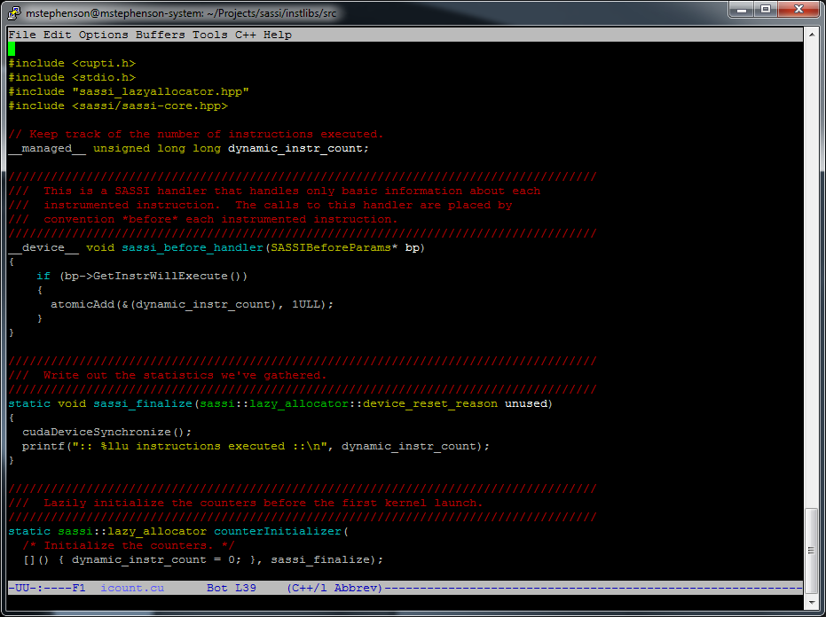
Anatomy of an instrumentation library
Device-side code
Various “handlers” that SASSI injects calls to

Slide 39
Anatomy of an instrumentation library
Device-side code
Various “handlers” that SASSI injects calls to
Device-side counters
UM makes things way simpler!

Slide 40
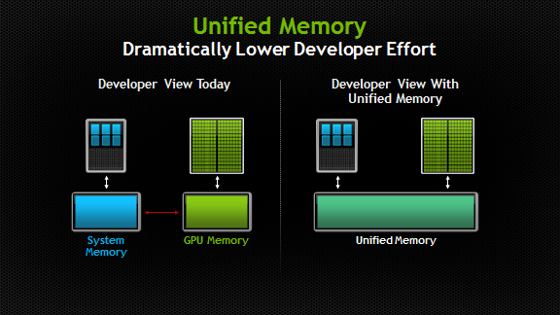
Unified memory
Unified Memory is available on CUDA 6+
cudaMallocManaged allocates memory that is available on both host and device
Or use __managed__ keyword for statically allocated memory
Old Memory Perception
New Perception with Unified Memory
What if we store SASSI statistics in GPU memory with this model?
What if we store SASSI statistics in GPU memory with this model?

Slide 41
Anatomy of an instrumentation library
Device-side code
Various “handlers” that SASSI injects calls to
Device-side counters
UM makes things way simpler!
Host-side code
Initialization
E.g., Initialize counters to zero
Finalization
E.g., Dump statistics to a file

Slide 42
Anatomy of a SASSI-instrumented app
IMPORTANT NOTE: We are not limited to nvvm and CUDA! We should be able to handle anything that generates PTX
Compile application
SASSI
Ahead-of-time compilation
nvvm
ptxas
nvlink
PTX
SASS
application.cu
Why do we limit the number of registers the handler uses?
GPU
nvcc
nvcc
Use --maxrregs=16 to cap register usage of instrumentation handler
nvvm
ptxas
handler.cu
PTX
SASS
Compile instrumentation handler
Notes:
Important to note: we can handle anything that generates PTX
Why do we limit the number of registers in a handler to 16?

Slide 43
Example 1: count instructions
Device-side code
class SASSIBeforeParams {
Public:
__device__ SASSIOpcodes GetOpcode() const;
__device__ int32_t GetID() const;
__device__ int32_t GetInsOffset() const;
__device__ const char *GetFnName() const;
__device__ const BB *GetBB() const;
__device__ int32_t GetInsOffset() const;
__device__ int64_t GetPUPC() const;
__device__ bool GetInstrWillExecute() const;
__device__ bool IsMem() const;
__device__ bool IsMemRead() const;
__device__ bool IsMemWrite() const;
__device__ bool IsSpillOrFill() const;
__device__ bool IsSurfaceMemory() const;
__device__ bool IsControlXfer() const;
__device__ bool IsCondControlXfer() const;
__device__ bool IsSync() const;
__device__ bool IsNumeric() const;
__device__ bool IsTexture() const;
};
Allocate a UM managed counter to record the total number of executed instructions
__managed__ unsigned long long dynamic_instr_count;
__device__ void sassi_before_handler(SASSIBeforeParams *bp)
{
if (bp->GetInstrWillExecute())
{
atomicAdd(&(dynamic_instr_count), 1ULL);
}
}
We will compile our applications to inject a call to this function before every instruction
Use CUDA’s atomicAdd to atomically increment our counter
Check to see if the instruction will execute

Slide 44
Example 1: count instructions
Host-side code (lazy_allocator)
static void sassi_finalize(sassi::lazy_allocator::device_reset_reason unused)
{
cudaDeviceSynchronize();
printf(":: %llu instructions executed ::\n", dynamic_instr_count);
}
static sassi::lazy_allocator counterInitializer(
[]() { dynamic_instr_count = 0; },
sassi_finalize);
Uses CUPTI to provide host-side callbacks
Initialization callback
Finalization callback
Pre-kernel launch callback
Post-kernel exit callback
Initialize our counter to zero before first kernel launch
Print out the results before the program exits

Slide 45
Example 1: count instructions
Compiling the application to inject the instrumentation
Target sm_30
Position independent code
nvcc –O3 -gencode=compute_30,code=sm_30 –rdc=true
-Xptxas –sassi-inst-before=“all”
Insert instrumentation before all instructions

Slide 46
Example 1: count instructions
Compiling the instrumentation handler
Target sm_30
Position independent code
nvcc –O3 -gencode=compute_30,code=sm_30 –rdc=true
-std=c++11 --maxrregcount=16
-I<include paths>
Use exactly 16 registers! No more, no less.
I use C++11 where I can for convenience
Don’t instrument your handlers!

Slide 47
Example 1: count instructions
Linking the instrumented application with your handler
Target sm_30
nvcc –o <appname> -gencode=compute_30,code=sm_30
(-L<library path> -l<lib>)+
-L/usr/local/sassi7/extras/CUPTI/lib64 -lcupti

Slide 48
Example 1: count instructions
Device-side code revisited
__managed__ unsigned long long dynamic_instr_count;
__device__ void sassi_before_handler(SASSIBeforeParams *bp)
{
if (bp->GetInstrWillExecute())
{
atomicAdd(&(dynamic_instr_count), 1ULL);
}
}
Is there a faster way to collect this statistic in this handler?

Slide 49
Example 1: count instructions
Faster device-side code
__managed__ unsigned long long dynamic_instr_count;
__device__ void sassi_before_handler(SASSIBeforeParams *bp)
{
if (bp->GetInstrWillExecute())
{
int participating = __ballot(true);
int threadIdxInWarp = get_laneid();
int firstActiveThread = (__ffs(participating)-1); /*leader*/
int numExecuting = __popc(participating);
if (threadIdxInWarp == firstActiveThread) {
atomicAdd(&(dynamic_instr_count), numExecuting);
}
}
}
Get the active thread mask
Get the thread’s lane ID within the warp: 0..31
Find number of active threads with __popc
Find the first bit set in the active mask: 1..32
If this thread corresponds to the first active thread, tally the results; other threads will exit the function
Now, exactly one thread per warp will perform atomicAdd

Slide 50
SASSI header files
With the SASSI-enabled ptxas, the header files define the API
The header files are the most up-to-date documentation
They are installed in <SASSI INSTALL_DIR>/include/sassi/
In the AWS image, the SASSI installation directory is /usr/local/sassi7

Slide 51
SASSI setup
Let’s log in to AWS and get things setup
Open up a console with ssh installed
ssh sassiuser@<machine name>.amazonaws.com
Password is nvidia
You should have root on that machine
Add the editor of your choice (if it’s not already there)

Slide 52
Interactive examples
Vanilla build – don’t instrument the code
cuobjdump to look at the code generated
SASSI ptxas options: ptxas –h (and look for --sassi options)
Look at header file directory
Build simple handler
Count instructions
Write opcode histogram handler
Solution folder

Slide 53
Interactive examples
Vanilla build of sample application: CUDA SDK matrix multiply
cd ~/SASSI/tutorial/session1/none
Make
Study each build step
Feel free to run it
./matrixMul_none
Let’s look at the SASS
cuobjdump –sass matrixMul_none

Slide 54
Interactive examples
SASSI ptxas Options
List all of the ptxas (and SASSI) options
ptxas –h
Look for the “—sassi” options

Slide 55
Interactive examples
Look at the header files
All of the parameters that SASSI passes to your instrumentation handlers are described here:
SASSI installation folder/include/sassi
Let’s check them out on AWS
cd /usr/local/sassi7/include/sassi
There are parameters that describe
Basic blocks (sassi-bb.hpp), conditional branch behavior (sassi-branch.hpp), baseline instruction information (sassi-core.hpp), function/kernels (sassi-function.hpp), memory behavior (sassi-memory.hpp), opcodes (sassi-opcodes.h), register usage (sassi-regs.hpp), data types (sassi-types.h)

Slide 56
Interactive examples
Build a simple handler to count instructions
cd ~/SASSI/tutorial/session1/count
make
Builds count_handler.cu, instruments application, links them together
Run it on the sample application
./matrixMul_count
Look at sassi-count.txt

Slide 57
Interactive examples
Write a handler to create an opcode histogram
cd ~/SASSI/tutorial/session1/ophist
Fill in the stubbed out code in ophist_handler.cu
The solution is in the solutions subdirectory
make
Run it on the sample application
./matrixMul_ophist
Look at sassi-ophist.txt

Slide 58
Break

Slide 59
Control Flow Analysis

Slide 60
1 | Control Flow Per Instruction
2 | Branches
3 | Interactive
Session 2

Slide 61
Control Flow
NVIDIA architectures are SIMT
Warps execute in SIMT fashion
Active mask selects which threads within the warp actively execute
When a branch is executed, threads within a warp might diverge
Predication is an alternative to branches

Slide 62
Control Divergence
32 threads per warp
(p) BRA L4
p
p
p
p
p
p
p
p
p
p
p
p
p
p
p
p
p
p
p
p
p
p
p
p
p
p
p
p
p
p
p
p

Slide 63
Control Divergence
BRA
32 threads per warp
(p) BRA L4
p
p
p
p
p
p
p
p
p
p
p
p
p
p
p
p
p
p
p
p
p
p
p
p
p
p
p
p
p
p
p
p
Push mask of “alternate” path
Set active mask to “main” path
Execute to convergence point
Pop state
Reset PC to diverge point
Set active mask to “alternate”
Execute to convergence point
0x51080E00
0xFFFFFFFF
Stack
0xFFFFFFFF
Active

Slide 64
Control Divergence
BRA
32 threads per warp
(p) BRA L4
p
p
p
p
p
p
p
p
p
p
p
p
p
p
p
p
p
p
p
p
p
p
p
p
p
p
p
p
p
p
p
p
Push mask of “alternate” path
Set active mask to “main” path
Execute to convergence point
Pop state
Reset PC to diverge point
Set active mask to “alternate”
Execute to convergence point
0x51080E00
0xFFFFFFFF
Stack
0xAEF7F1FF
Active

Slide 65
Control Divergence
BRA
32 threads per warp
CONVERGE
p
p
p
p
p
p
p
p
p
p
p
p
p
p
p
p
p
p
p
p
p
p
p
p
p
p
p
p
p
p
p
p
p
p
p
p
p
p
p
p
p
p
p
p
p
p
p
p
p
p
p
p
p
p
p
p
p
Push mask of “alternate” path
Set active mask to “main” path
Execute to convergence point
Pop state
Reset PC to diverge point
Set active mask to “alternate”
Execute to convergence point
0x51080E00
0xFFFFFFFF
Stack
0xAEF7F1FF
Active

Slide 66
Control Divergence
BRA
32 threads per warp
(p) BRA L4
p
p
p
p
p
p
p
p
p
p
p
p
p
p
p
p
p
p
p
p
p
p
p
p
p
p
p
p
p
p
p
p
Push mask of “alternate” path
Set active mask to “main” path
Execute to convergence point
Pop state
Reset PC to diverge point
Set active mask to “alternate”
Execute to convergence point
0xFFFFFFFF
Stack
0x51080E00
Active

Slide 67
Control Divergence
BRA
32 threads per warp
CONVERGE
p
p
p
p
p
p
p
p
p
p
p
p
p
p
p
p
p
p
p
p
p
p
p
p
p
p
p
p
p
p
p
p
p
p
p
p
p
p
p
Push mask of “alternate” path
Set active mask to “main” path
Execute to convergence point
Pop state
Reset PC to diverge point
Set active mask to “alternate”
Execute to convergence point
0xFFFFFFFF
Stack
0x51080E00
Active

Slide 68
Control Divergence
32 threads per warp
(p) BRA L4
p
p
p
p
p
p
p
p
p
p
p
p
p
p
p
p
p
p
p
p
p
p
p
p
p
p
p
p
p
p
p
p
p
p
p
p
p
p
p
p
p
p
p
p
p
p
p
p
p
p
p
p
p
p
p
p
p
int active = __ballot(true);
0xAEF7F1FF

Slide 69

Example 2: SIMT WARP utilization
Add instrumentation before all instructions
Look at the active mask (bitmask representing participating SIMT lanes)
Count bits set in active mask to collect SIMT warp utilization
Elect a warp leader to record results (histogram of active threads/warp)
Two main requirements of instrumenting an application
Writing instrumentation handler
Compiling the application to inject the instrumentation

Slide 70
Example 2: SIMT WARP utilization
Writing the Instrumentation Handler
__device__ void sassi_before_handler(SASSIBeforeParams* bp)
{
if (bp->GetInstrWillExecute())
{
int workset_bitmask = __ballot(1);
int num_active = __popc(workset_bitmask);
int leader = __ffs(workset_bitmask) - 1;
if (get_laneid() == leader) {
atomicAdd( &(histogram_active_threads_per_warp[num_active]), 1LL);
}
}
}
only execute this handler for instructions that will actually execute
(i.e., skip instructions that are predicated off … we’ll get to this in a minute)
This handler executes before all instructions
collect bitmask of active threads in current warp
compute how many threads are active in this warp
let the leader tally the result for this warp
elect the first active thread as the leader
use an atomic to safely accumulate the histogram update for this warp

Slide 71
Example 2: warp utilization
Compiling the application to inject the instrumentation
Target sm_30
Position independent code
Compiling the application
nvcc –O3 -gencode=compute_30,code=sm_30 -O3 –rdc=true
-Xptxas –sassi-inst-before=“all”
Insert instrumentation before all instructions

Slide 72
PREDICATION
NVIDIA’s architectures also feature predication
Converts control flow to dataflow
Note that predicates are orthogonal to the active mask
SASSIBeforeParams::GetInstrWillExecute() returns true iff the instruction will commit results
Conditional branches can be predicated jumps!
ISETP.LT.AND P1, PT, R7, RZ, PT;
!P0 MOV R0, RZ;
P0 MOV32I R0, 0xffffffc0;
P0 FFMA R4, R4, 1.84467440737095516160e+19, RZ;
P1 FFMA R5, R5, 1.84467440737095516160e+19, RZ;

Slide 73
Profiling control flow with sassi
There are a few control flow profiling options
Add instrumentation before (conditional) branches, pass conditional branch information
Instrument basic block entries (Session 4)
Instrument kernel/function entries (Session 4)
nvcc -gencode=compute_30,code=sm_30 -O3 –rdc=true
-Xptxas –sassi-inst-before=“control-flow”
-Xptxas –sassi-before-args=“cond-branch-info”
nvcc -gencode=compute_30,code=sm_30 -O3 –rdc=true
-Xptxas –sassi-bb-entry
nvcc -gencode=compute_30,code=sm_30 -O3 –rdc=true
-Xptxas –sassi-function-entry

Slide 74
Profiling control flow with sassi
Add instrumentation before branches
Will insert instrumentation before all control-flow redirecting instructions
E.g., conditional branches, jumps, calls
Will also pass information about conditional branches to your instrumentation handler
This argument will be NULL for unconditional branches
nvcc –O3 -gencode=compute_30,code=sm_30 -O3 –rdc=true
-Xptxas –sassi-inst-before=“control-flow”
-Xptxas –sassi-before-args=“cond-branch-info”

Slide 75
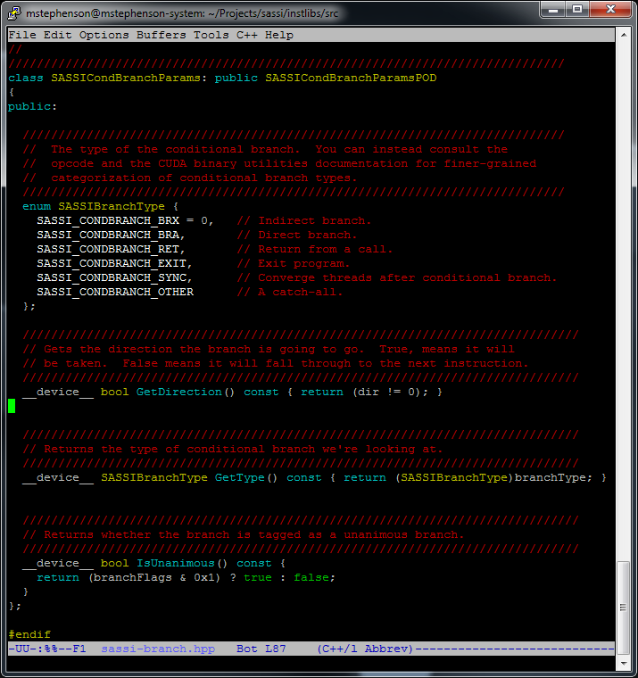
Example 3: Control divergence
Insert a call to this handler before conditional branches
__device__ void sassi_before_handler(SASSIBeforeParams *bp, SASSICondBranchParams *brp) {
int threadIdxInWarp = get_laneid();
int active = __ballot(1);
bool dir = brp->GetDirection();
int taken = __ballot(dir == true);
int ntaken = __ballot(dir == false);
int numActive = __popc(active);
int numTaken = __popc(taken);
int numNotTaken = __popc(ntaken);
bool divergent = (numTaken != numActive && numNotTaken != numActive);
if (((__ffs(active)-1) == threadIdxInWarp) && divergent) {
atomicAdd(&diverged_branches, 1ULL);
}
}
Find the lane number in warp
Get the active mask
Get the direction that the branch will go
Get set of lanes that are taking/not taking branch, respectively
__popc counts set bits in mask
Elect one leader per warp to record results
__ffs finds first set bit

Slide 76
Example 3: Control divergence
Insert a call to this handler before conditional branches
__device__ void sassi_before_handler(SASSIBeforeParams *bp, SASSICondBranchParams *brp) {
int threadIdxInWarp = get_laneid();
int active = __ballot(1);
bool dir = brp->GetDirection();
int taken = __ballot(dir == true);
int ntaken = __ballot(dir == false);
int numActive = __popc(active);
int numTaken = __popc(taken);
int numNotTaken = __popc(ntaken);
bool divergent = (numTaken != numActive && numNotTaken != numActive);
if (((__ffs(active)-1) == threadIdxInWarp) && divergent) {
atomicAdd(&diverged_branches, 1ULL);
}
}
Why don’t we check whether this instruction will execute? i.e., Why not do bp->GetInstrWillExecute()?

Slide 77
pitfalls
Things to watch out for
Conditional branches are just predicated jumps
You might be tempted to use __cudaSyncThreads() in your handlers
This is not safe!

Slide 78
Interactive exampleS
Write active mask analysis
Write branch bias analysis
See what fraction of the time the conditional branch is unanimous (i.e., not divergent) and the branch is taken
Might hinder the icache performance
Use Rodinia’s bfs as a sample application

Slide 79
Interactive examples
Write active mask analysis
cd ~/SASSI/tutorial/session2/active
Fill in the stubbed out code in active_handler.cu
The solution is in the solution subdirectory
make
Run it on sample application
./bfs_active input/graph1MW_6.txt
(or do make –f active.mk run)
Look at sassi-active.txt

Slide 80
Interactive examples
Write branch bias analysis
cd ~/SASSI/tutorial/session2/bbias
Fill in the stubbed out code in bbias_handler.cu
The solution is in the solution subdirectory
make
Run it on sample application
./bfs_bbias input/graph1MW_6.txt
Look at sassi-bbias.txt

Slide 81
1 | Data/Register Analysis
2 | Memory Analysis
3 | Interactive
Session 3

Slide 82
Data/Register Analysis

Slide 83
SASSI register analysis
SASSI can be used to inspect the source and destination registers of all instructions
Register numbers, data types, and values therein
Values are 32-bit numbers
For looking at source values, I recommend instrumenting before instructions
Source registers may be clobbered by instruction, e.g., r4 = ld[r4]
For looking at destination values, you must instrument after instructions

Slide 84
Sassi REGISTER analysis
Add instrumentation before instructions
nvcc -gencode=compute_30,code=sm_30 -O3 –rdc=true
-Xptxas –sassi-inst-before=“reg-reads”
-Xptxas –sassi-before-args=“reg-info”
Only add the instrumentation before instructions that read registers
Pass register information

Slide 85
Sassi REGISTER analysis
Add instrumentation after instructions
nvcc -gencode=compute_30,code=sm_30 -O3 –rdc=true
-Xptxas –sassi-inst-after=“reg-writes”
-Xptxas –sassi-after-args=“reg-info”
Only add the instrumentation after instructions that write registers
Pass register information

Slide 86
Sassi REGISTER analysis
--sassi-iff-true-predicate-handler-call
Only add the instrumentation after instructions that write registers
nvcc -gencode=compute_30,code=sm_30 -O3 –rdc=true
-Xptxas –sassi-inst-after=“reg-writes”
-Xptxas –sassi-after-args=“reg-info”
-Xptxas –sassi-iff-true-predicate-handler-call
Pass register information
Don’t call the instrumentation handler unless it actually will (or did) execute

Slide 87
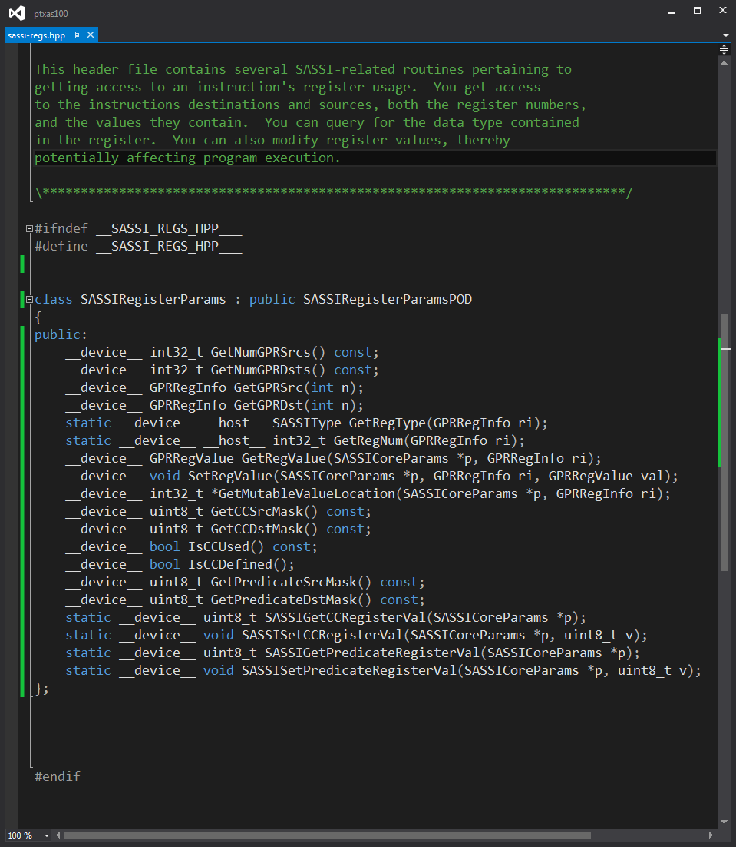
Example 4: Register analysis
Find “scalar” values
Can modify values in registers as well as reading them
__device__ void sassi_after_handler(SASSIAfterParams* ap, SASSIRegisterParams *rp)
{
int threadIdxInWarp = get_laneid();
int firstActiveThread = (__ffs(__ballot(1))-1);
uint64_t pupc = ap->GetPUPC();
SASSOp *stats = sassi_stats->getOrInit(pupc, [&rp](SASSOp *v) { SASSOp::init(v, rp); });
atomicAdd(&(stats->weight), 1);
for (int d = 0; d < rp->GetNumGPRDsts(); d++) {
SASSIRegisterParams::GPRRegInfo regInfo = rp->GetGPRDst(d);
SASSIRegisterParams::GPRRegValue regVal = rp->GetRegValue(ap, regInfo);
int leaderValue = __shfl(regVal.asInt, firstActiveThread);
int allSame = (__all(regVal.asInt == leaderValue) != 0);
if (threadIdxInWarp == firstActiveThread)
atomicAnd(&(stats->operands[d].isScalar), allSame);
}
}

Slide 88
Example 4: Register analysis
Find “scalar” values
__device__ void sassi_after_handler(SASSIAfterParams* ap, SASSIRegisterParams *rp)
{
int threadIdxInWarp = get_laneid();
int firstActiveThread = (__ffs(__ballot(1))-1);
uint64_t pupc = ap->GetPUPC();
SASSOp *stats = sassi_stats->getOrInit(pupc, [&rp](SASSOp *v) { SASSOp::init(v, rp); });
atomicAdd(&(stats->weight), 1);
for (int d = 0; d < rp->GetNumGPRDsts(); d++) {
SASSIRegisterParams::GPRRegInfo regInfo = rp->GetGPRDst(d);
SASSIRegisterParams::GPRRegValue regVal = rp->GetRegValue(ap, regInfo);
int leaderValue = __shfl(regVal.asInt, firstActiveThread);
int allSame = (__all(regVal.asInt == leaderValue) != 0);
if (threadIdxInWarp == firstActiveThread)
atomicAnd(&(stats->operands[d].isScalar), allSame);
}
}
Find the lane number
Find the first active thread in the warp
Hash into a dictionary using the PC as the key
Get the PC … well, something resembling a PC
Iterate over all the destination registers
Get the GPRRegInfo for the destination register – type information and reg number
Get the value in the register
All threads use __shfl to get the first active thread’s value of regVal
If every thread matches the leader’s value, then the register is scalar; use __all
Let the leader record the result
If there’s no entry, this lambda function is invoked
This was initialized to true before the first kernel launch
This type is a union, so you can get to the bits in regVal as an int, unsigned, or float

Slide 89
Memory Analysis

Slide 90
SASSI Memory Instrumentation
Selectively Instrument Only Memory Instructions
Analyze addresses
Global, local, shared memory spaces
Analyze data values being loaded, stored
TODO: <…insert more discussion here>

Slide 91
SASSI Memory Instrumentation
Inject instrumentation before memory instructions
Compiling the application
nvcc –O3 -gencode=compute_30,code=sm_30 -O3 –rdc=true
-Xptxas –sassi-inst-before=“memory”
-Xptxas --sassi-before-args="mem-info"
Insert instrumentation before memory instructions
Pass memory information to the handler

Slide 92
Example 5: Memory Address Divergence
What is memory address divergence?
Each thread in a warp can request a unique address (gather/scatter)
Memory requests are coalesced across threads in a warp
Number of requests reduced to minimum required to fetch all unique cache lines
Memory address divergence: warp requests multiple (possibly unaligned or non-sequential) cache lines
Goal: Collect a histogram of number of unique memory requests generated for each warp-wide memory instruction
Count total number of coalesced (unique) cache lines accessed

Slide 93
Example 5: Memory Address Divergence
Writing the Instrumentation Handler
__device__ void sassi_before_handler(SASSIBeforeParams *bp, SASSIMemoryParams *mp)
{
if (bp->GetInstrWillExecute()) { return; }
intptr_t address = mp->GetAddress();
if (!__isGlobal((void*)address)) { return; }
intptr_t line_address = address >> LINE_BITS;
unsigned unique_lines = 0;
int workset_bitmask = __ballot(1);
int unmatched_mask = workset_bitmask;
while (unmatched_mask) {
...
(continued on next slide)
Skip instructions that won’t execute
This function called before every memory operation
Get each thread’s request address
Global memory space only
Skip shared or local (thread-private) memory for this handler
Convert address to line address
Collect mask of active warp threads
Each thread tracks unique line addresses across the warp
All threads have addresses that are not yet accounted for to start
Perform N-to-N comparison of line addresses requested across all active threads in the current warp

Slide 94
Example 5: Memory Address Divergence
Writing the Instrumentation Handler
… (continued from previous slide)
while (unmatched_mask != 0) {
int leader = __ffs(unmatched_mask) - 1;
intptr_t leaders_address = __broadcast<intptr_t>(line_address, leader);
bool nomatch = leaders_address != line_address;
int not_matched = __ballot(nomatch);
unmatched_mask = unmatched_mask & not_matched;
unique_lines++;
}
int leader = __ffs(workset_bitmask) - 1;
if (get_laneid() == leader) { atomicAdd(&(memdiv_histogram[unique_lines]), 1LL); }
Broadcast leader’s address for comparison
Elect a leader for this iteration
Choose a leader who has an address we have not accounted for yet
Iterate until all threads are accounted for
Compare thread address with leader and collect mask of unmatched threads via ballot
Remove threads that ‘matched’ from the unmatched mask each iteration.
(in other words, keep only threads that don’t match this time and haven’t matched yet previously)
Increment unique lines found
As earlier, record result
Notes:
// elect a leader for this iteration, get it
// get the leader's cache
// compare against the leader's address
// we want to remove all redundant addresses
// so get a mask of the remaining unmatched threads who have not yet matched a leader's address
line addresss line, see who all matches it.
// We have accounted for all values that match the leader's in this iteration
// Let's remove them all from the unmatched_mask, leaving only the threads that
// have not matched any leader's address yet
// (get rid of all threads except those that are not matched yet)
// tally unique cacheline request
// Each thread independently computed 'unique_lines'.
// Let's let the first active thread actually tally the result

Slide 95
pitfalls
Loads from constant memory not considered memory operations
Texture operations also not considered to be memory operations
Have much different semantics than standard loads and stores
Instrumenting “after” instructions, inputs to instrumented instructions may be clobbered
Repercussions for predicated instructions

Slide 96
Interactive examples
Write a scalar & zero register detector
Write a memory divergence handler

Slide 97
Interactive examples
Write scalar & zero register analysis
cd ~/SASSI/tutorial/session3/register
Fill in the stubbed out code in register_handler.cu
The solution is in the solution subdirectory
make
Run it on the sample application (Rodinia’s heartwall)
./heartwall_register input/test.avi 10
Look at sassi-register.txt

Slide 98
Interactive examples
Write memory divergence handler
cd ~/SASSI/tutorial/session3
Fill in the stubbed out code in memdiverge_handler.cu
The solution is in the solutions subdirectory
make
Run it on the sample application (Rodinia’s heartwall)
./heartwall_memdiverge
Look at sassi-memdiverge.txt

Slide 99
1 | CFG exploration, Function entry
2 | AWS image & Parboil suite
3 | Faking new ISA instructions
4 | Q & A
Session 4

Slide 100
The following are new features that haven’t yet been documented

Slide 101
BASIC block and function entry
Instrument basic block entries
Instrument function entries, including __global__ functions
Only instrument __global__ functions
nvcc -gencode=compute_30,code=sm_30 -O3 –rdc=true
-Xptxas –sassi-bb-entry
nvcc -gencode=compute_30,code=sm_30 -O3 –rdc=true
-Xptxas –sassi-function-entry
nvcc -gencode=compute_30,code=sm_30 -O3 –rdc=true
-Xptxas –sassi-kernel-entry

Slide 102
Sassi has access to static cfg
SASSI provides basic block information
Basic block identifier
Addresses of every instruction in the block
Successors of the basic block
Register liveness information of the block
Name of function in which block is contained
Instruction instrumentation even provides a pointer to the enclosing basic block

Slide 103
Function entry
Function entry instrumentation handlers are passed an array of basic block descriptors
Represents the body of the function
Block 0 is the entry
Function exits can be discovered by scanning through the blocks
Blocks contain an IsExitBlock() function

Slide 104
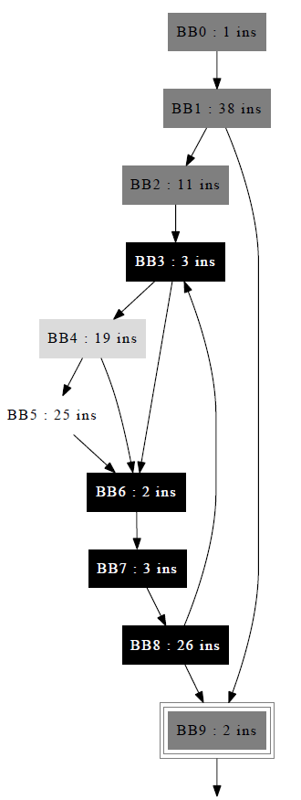
Example 5: dump weighted cfg
Instrument function entries
Create a deep copy of the CFG to be exported to the host memory
Instrument basic block entries
Keep a dynamic count of the number of times each basic block is executed
Dump the statistics to a dot-formatted file at the end of the program

Slide 105
Example 5: dump weighted cfg
Writing the Instrumentation Handler
See ~/SASSI/tutorial/session4/cfg_handler.cu
Two handler callbacks
Function/Kernel entries
Basic block entries

Slide 106
Example 5: dump weighted cfg
fp is a device literal that describes this function (value will not change within a run)
Writing the function/kernel entry callback
__device__ void sassi_function_entry(SASSIFunctionParams* fp)
{
int numBlocks = fp->GetNumBlocks();
const SASSIBasicBlockParams * const * blocks = fp->GetBlocks();
CFG *cPtr = *(sassi_cfg->getOrInit((int64_t)fp, [numBlocks, blocks, fp](CFG **cfg) {
}));
__threadfence();
for (int bb = 0; bb < numBlocks; bb++) {
const SASSIBasicBlockParams *blockParam = blocks[bb];
BLOCK *blockPtr = &(cPtr->blocks[bb]);
sassi_cfg_blocks->getOrInit((int64_t)blockParam, [blockParam, blockPtr](BLOCK **bpp) {
});
}
}
Maintain dictionary to see if we’ve seen this fp; allocate memory to do a deep copy of the function’s CFG and name if not.
class SASSIFunctionParams {
public:
__device__ const char *GetFnName();
__device__ bool IsGlobal() const;
__device__ bool IsStatic() const;
__device__ int GetNumBlocks() const;
__device__ const SASSIBasicBlockParams* const * GetBlocks() const;
__device__ const SASSIBasicBlockParams *GetEntryBlock() const;
__device__ int GetStackUsed() const;
};
Each block in blocks is also a literal. We can key off of them.
Allocate space for CFG of BLOCKs; copy function name
Maintain mapping from SASSI’s blocks to our deep copy of the blocks.
Perform a deep copy of SASSIBasicBlockParams to our BLOCK

Slide 107
Example 5: dump weighted cfg
bb is a device literal that describes this basic block (value will not change within a run)
Writing the basic block entry callback
class SASSIBasicBlockParams {
public:
__device__ int32_t GetID() const;
__device__ const char *GetFnName() const;
__device__ bool IsEntryBlock() const;
__device__ bool IsExitBlock() const;
__device__ bool IsCallBlock() const;
__device__ int32_t GetNumInstrs() const;
__device__ uint32_t GetInstrOffset(unsigned n) const;
__device__ uint32_t GetInstrPUPC(unsigned n) const;
__device__ int32_t GetNumSuccs() const;
__device__ const SASSIBasicBlockParams* const *GetSuccs() const;
__device__ void LivenessInMap(nvstd::function<void(unsigned)> fn) const;
__device__ void LivenessOutMap(nvstd::function<void(unsigned)> fn) const;
};
__device__ void sassi_basic_block_entry(SASSIBasicBlockParams* bb)
{
BLOCK **blockStr = sassi_cfg_blocks->getOrInit((int64_t)bb, [](BLOCK **bpp) {
assert(0); // We should have initialized all blocks in function entry.
});
atomicAdd(&((*blockStr)->weight), 1);
}
Get the deep copy of the block based on the bb key
Increment the weight field of the block structure

Slide 108
Example 5: dump weighted cfg
Compiling the application to inject the instrumentation
Target sm_30
Position independent code
Compiling the application
nvcc –O3 -gencode=compute_30,code=sm_30 -O3 –rdc=true
-Xptxas -–sassi-bb-entry
-Xptxas –-sassi-function-entry
Insert instrumentation at basic block entry points
Insert instrumentation at function and kernel entries

Slide 109
Interactive examples
Dump the CFG
cd ~/SASSI/tutorial/session4
Look at cfg_handler.cu
make
Run it on the sample application
./heartwall_cfg input/test.avi 4
Look at sassi-cfg.txt

Slide 110
Faking new isa instructions
Not yet exposed, tons of sharp edges - WIP
One benefit of being in the compiler, SASSI can fake new ISA instructions
Use inline PTX to add new instructions that are passed all the way through the backend compiler as if they were SASS instructions
SASSI expands these instructions into a callback to a function in which the user can define the semantics of the application
SASSI instrumentation does not account for ABI bloat in performing the function call
E.g., --sassi-inst-before=“all” will treat the spills, call, functional emulation, and spills as a single atomic unit

Slide 111
Example 6: add new instruction
Inline PTX
Use inline assembly to insert your instruction
The sources are floats
This instruction template produces one destination and uses two sources: dss
The destination is a two-element vector of float: v2.f32
__global__ void toPolarKernel(cuFloatComplex *complex_nums, float2 *polar_nums)
{
int tid = threadIdx.x;
if (tid < N) {
float2 result;
asm volatile("sassi_dss.v2.f32.f32 {%0,%1},%2,%3,2;"
: "=f"(result.x),"=f"(result.y)
: "f"(complex_nums[tid].x), "f"(complex_nums[tid].y));
polar_nums[tid] = result;
}
}
PTX syntax for vector operands. The dest is a vector
%2 and %3 are sources
This is SASSI-specific. This number specifies the opcode for the template

Slide 112
Example 6: add new instruction
Defining the instruction
MOV R1, c[0x0][0x20]
S2R R0, SR_TID.X
ISETP.GT.AND P0, PT, R0, 0x7, PT
EXIT
SHL.W R2, R0.reuse, 0x3
SHR R0, R0, 0x1d
IADD R4.CC, R2, c[0x0][0x140]
IADD.X R5, R0, c[0x0][0x144]
LDG.E.64 R4, [R4]
IADD R6.CC, R2, c[0x0][0x148]
MOV R3, RZ
IADD.X R7, R0, c[0x0][0x14c]
IADD R1, R1, -0x60
STL [R1+0x28], R3
STL [R1+0x2c], R4
STL [R1+0x30], R5
STL [R1+0x34], R6
STL [R1+0x38], R7
DEPBAR {4,3,2,1,0}
JCAL 0x0
MOV R2, R4
LDL R7, [R1+0x38]
LDL R6, [R1+0x34]
LDL R5, [R1+0x30]
LDL R4, [R1+0x2c]
LDL R3, [R1+0x28]
IADD R1, R1, 0x60
NOP
STG.E.64 [R6], R2
DEPBAR {0}
EXIT
BRA 0x150
NOP
By contract, the inline assembly will call this function. Note the dss<opcode> signature
extern "C" __device__ float2 _sassi_fake_dss2(float r, float i)
{
float2 result;
result.x = i == 0.0 ? 0.0 : atanf(r / i);
result.y = sqrtf(r * r + i * i);
return result;
}
SASSI treats the spills, argument passing, call, operations performed in _sassi_fake_dss2, fills, and stack management as a single atomic unit

Slide 113
Example 6: add new instruction
Instrumenting with the new instruction
SASSI treats all code related to executing your fake instruction as a single atomic unit
Instrumenting before/after will go before/after the atomic unit
Still have access to register info
Will not disrupt the perceived CFG
Caveats
No templates support control flow instructions yet
Memory operands are supported, but no access to memory information yet
(Because SASSI doesn’t know the memory semantics of your instruction)

Slide 114
AWS Image
We can make this AWS image public if there’s interest
Contains Parboil setup to run with SASSI
cd parboil
make {branch cfg none memdiverge opcode ophist valueprof}
We could potentially add other suites as well

Slide 115
Thank you for attending! Questions?

